Slide 1
RISC-V -PROJECT
NAME :HARSHAK G,SRN:PES2UG20EC145
DARSHAN BS,SRN:PES2UG20EC143
KARTHIK M ,SRN:PES2UG20EC147
PROGRAM:BTECH
BRANCH:ELECTRONICS AND COMMUNICATION ENGINEERING
SEM-V
SUBJECT CODE-UE20EC302

Slide 2
Contents:
Karatsuba Algorithm (using Codasip)
Single Cycle Processor using R Type Instructions(using Quartus tool)

Slide 3
Karatsuba Algorithm
The Karatsuba algorithm is a fast multiplication algorithm that uses a divide and conquer approach to multiply two numbers.
In order to multiply two integers of n-bits, Karatsuba algorithm uses divide and conquer technique and takes O(nlog 3) bit operations. Karatsuba algorithm performs multiplication operation by replacing some multiplications with subtraction and addition operations which are less costly.

Slide 4
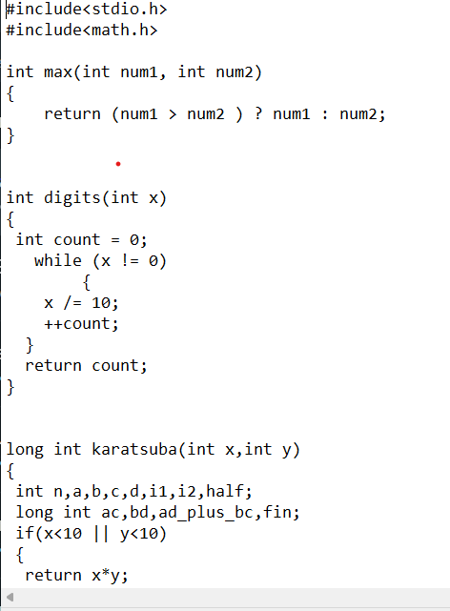
Code: WITHOUT OPTIMISATION
Notes:
Page 1/2

Slide 5
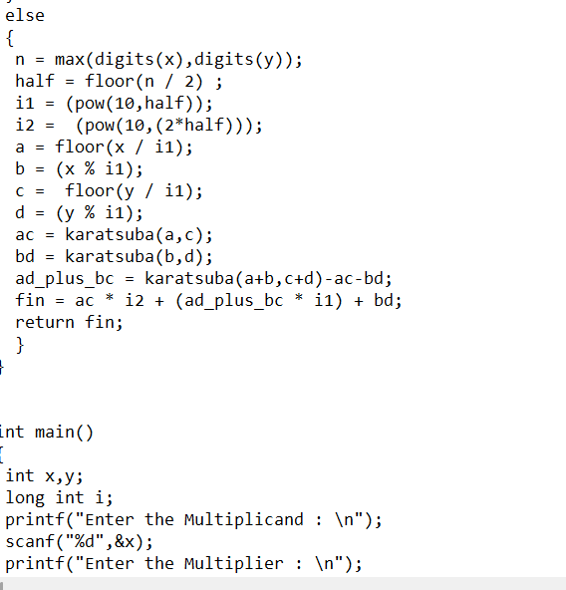
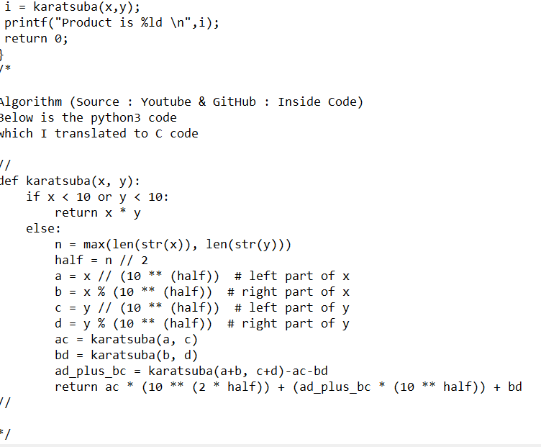

Slide 6
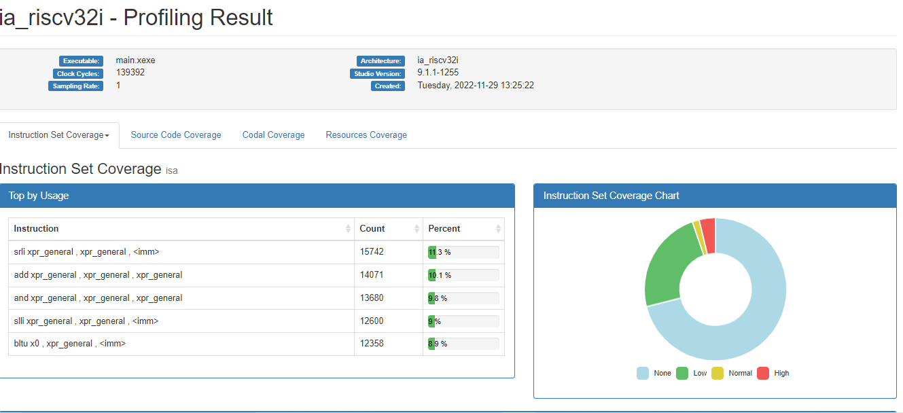
BEFORE OPTIMISATION (00gcc )

Slide 7
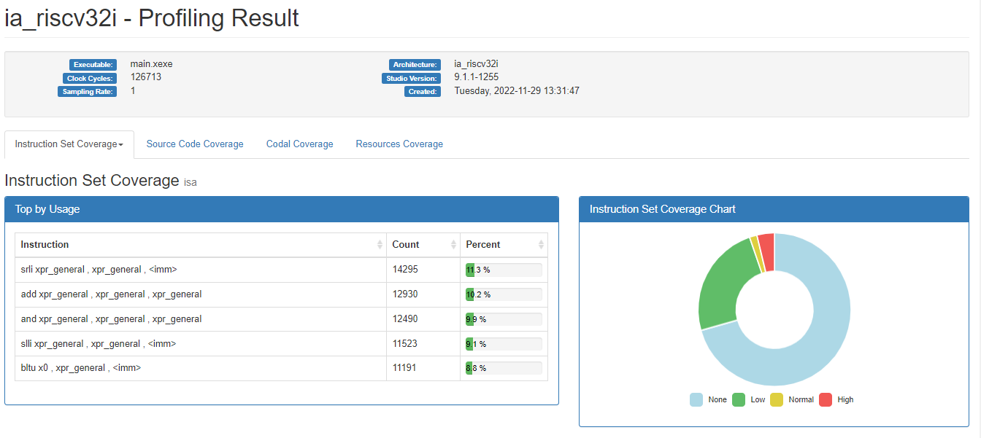
BEFORE OPTIMISATION (03gcc )

Slide 8
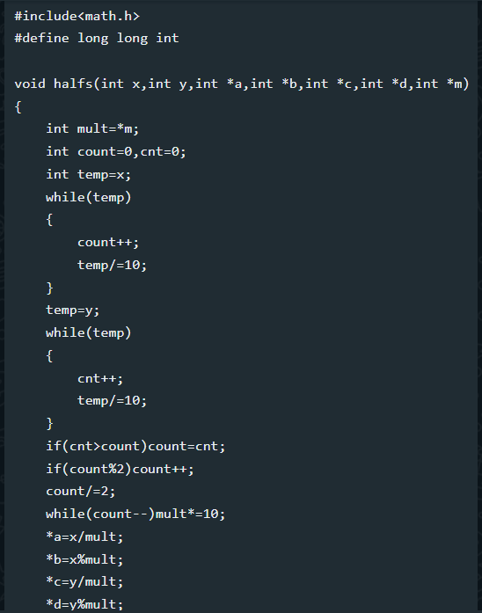
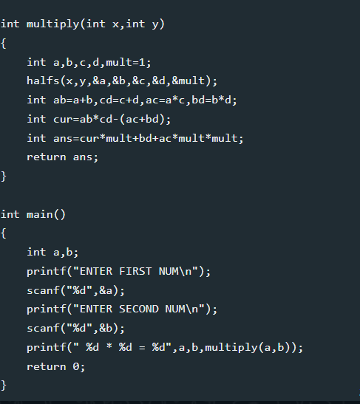
Code after optimisation

Slide 9
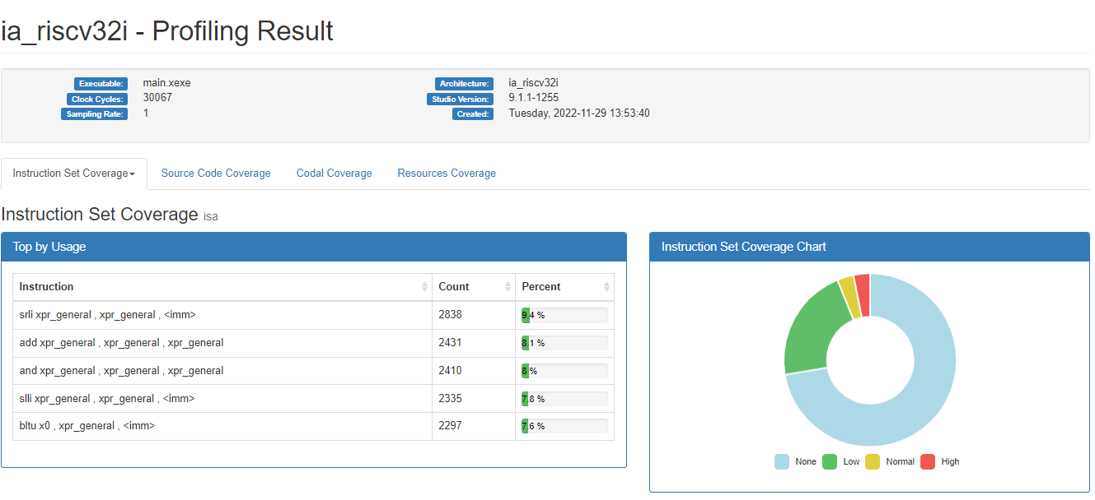
Code: After optimization(00gcc)

Slide 10
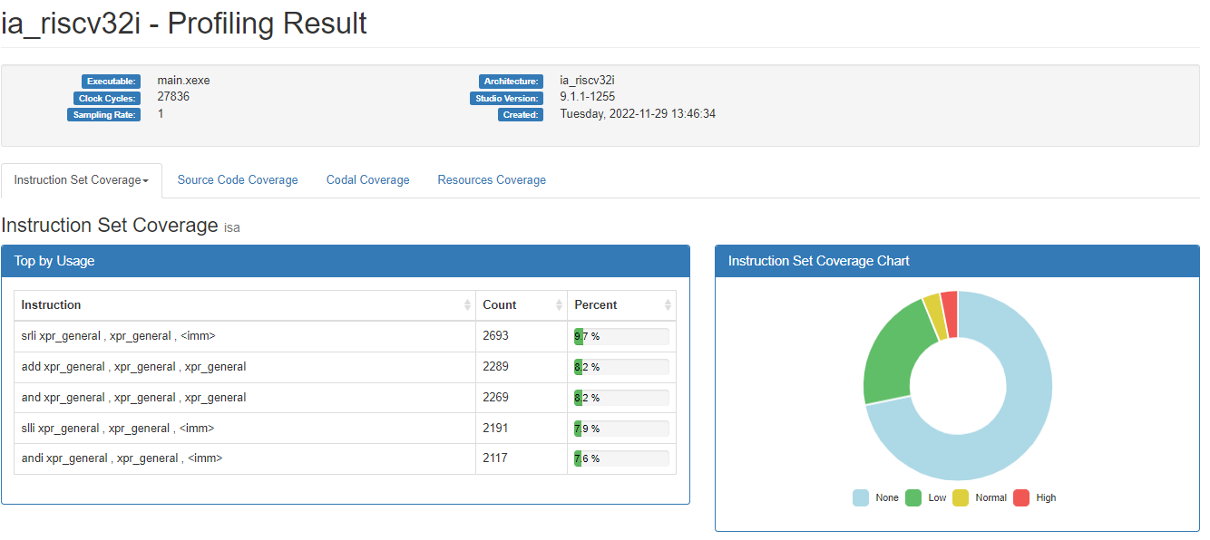
code : after Optimization(03gcc)

Slide 11
Optimisation result table
COMPILER | UNOPTIMISED | OPTIMISED
(00GCC) | 139392 | 30067
(03GCC) | 126713 | 27836

Slide 12
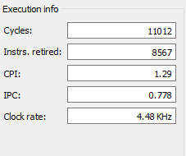
RIPES EXECUTION RESULTS
CYCLES | WITH M EXTENSION | WITHOUT M EXTENSION
00GCC | 11012 | 24442
03GCC | 10783 | 24245

Slide 13
Part 2 : Single cycle processor for R Type instructions.

Slide 14
Different components of this processor:
Pc Counter
Instruction Memory
Decoder
Controller
Register File
ALU Control
Alu
ALU Result

Slide 15
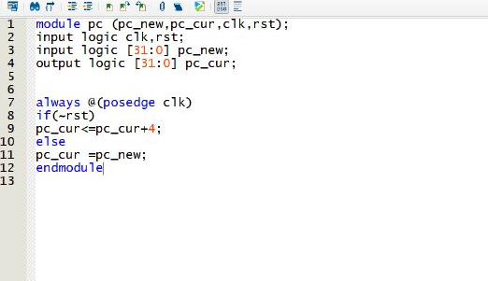
Code : pc

Slide 16
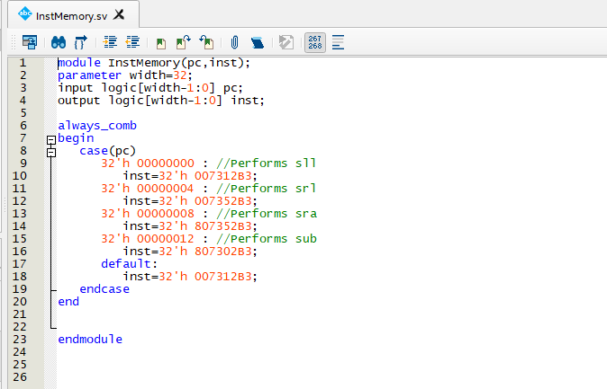
Code : Instruction Memory

Slide 17
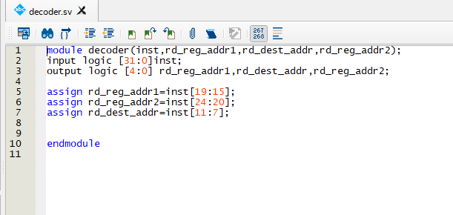
Code : Decoder

Slide 18
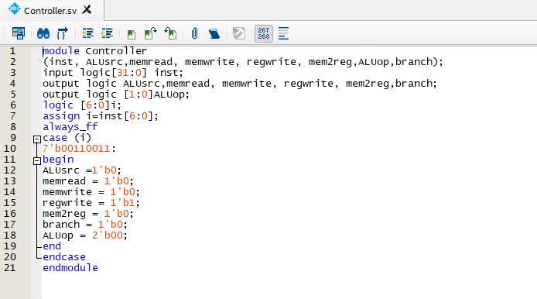
Code : Controller

Slide 19
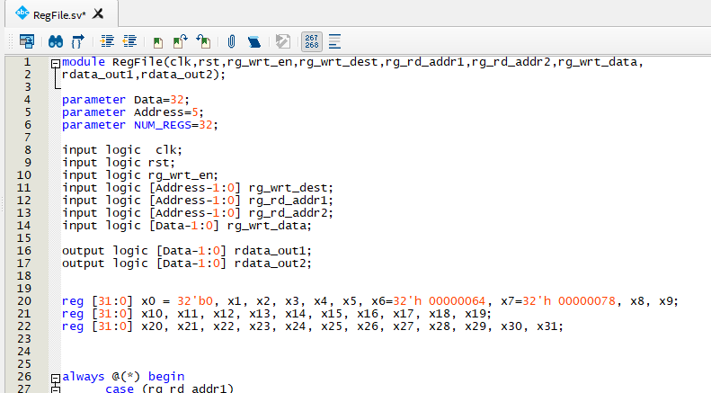
Code : Register File

Slide 20
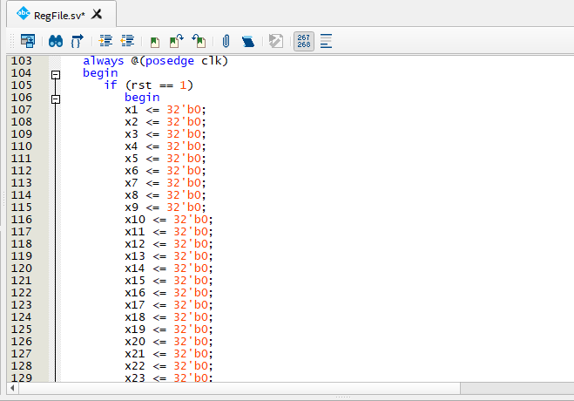
Register File

Slide 21
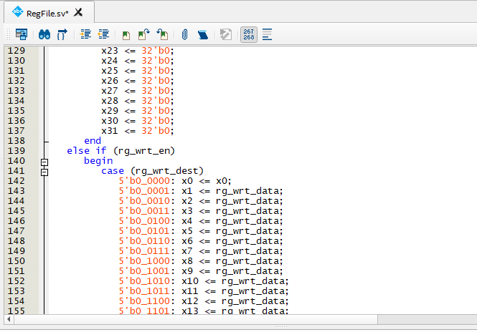
Register File

Slide 22
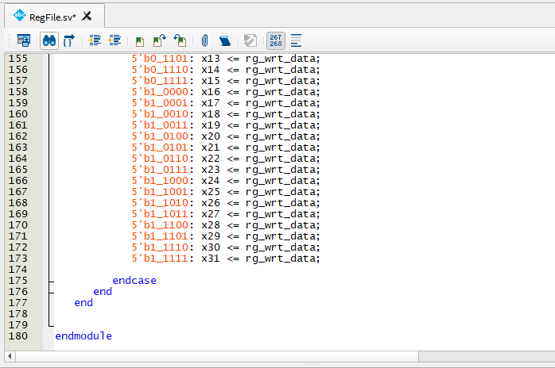
Register File

Slide 23
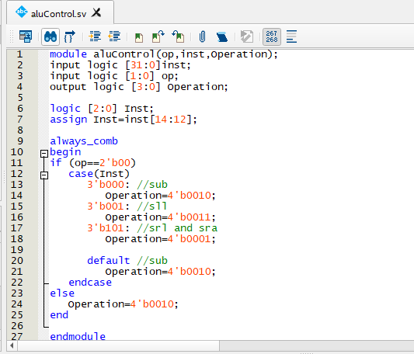
Code: ALU Control

Slide 24
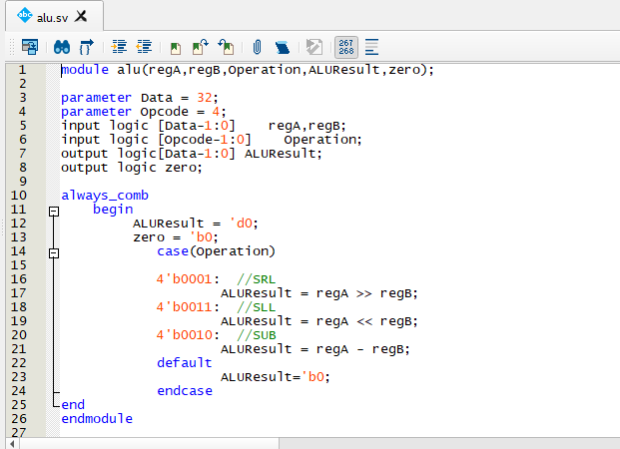
Code : ALU

Slide 25
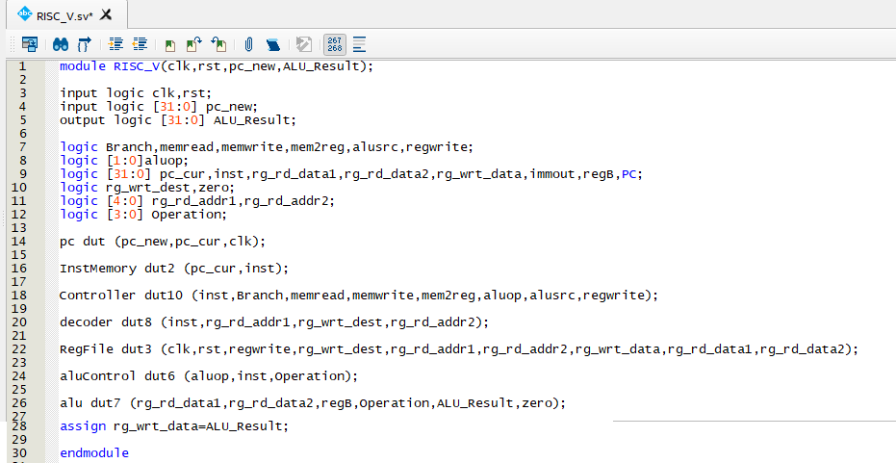
Code : RISC_V

Slide 26
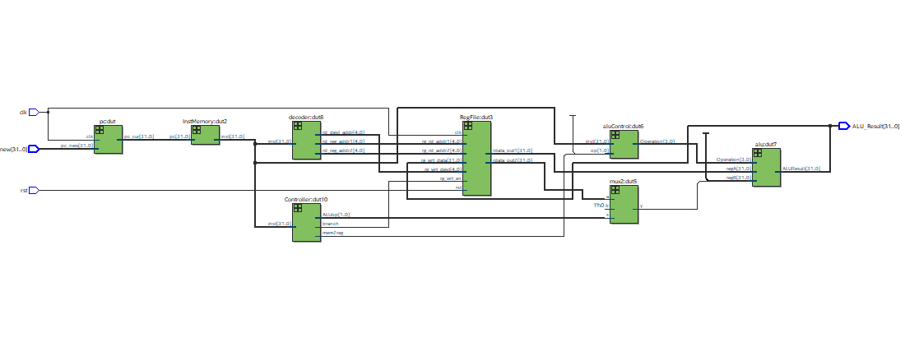
RTL Simulation

Slide 27
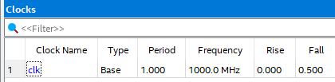
OUTPUT report :

